Slide 1
Cities: Skylines and Sustainable Urban Development
Exploring Educational Opportunities and Challenges

Slide 2
Introduction
Importance of innovative educational tools
Overview of the research paper

Slide 3
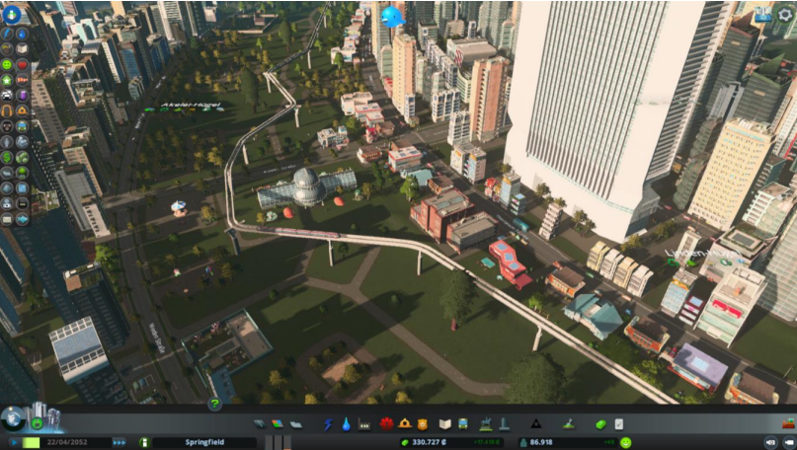
Motivation and Aims
Motivation behind the study
Aims and hypotheses

Slide 4
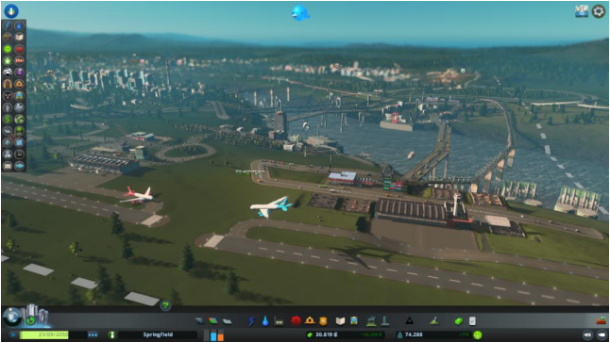
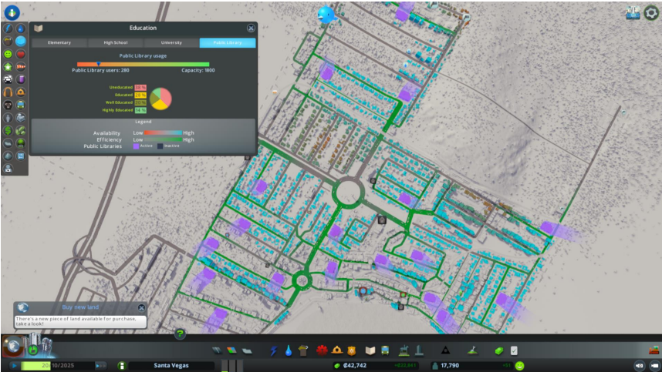
Contribution and Methodology
Analysis of C:S
Five key dimensions:
land management
Environment
Mobility
Social
economy
Proposed educational applications

Slide 5
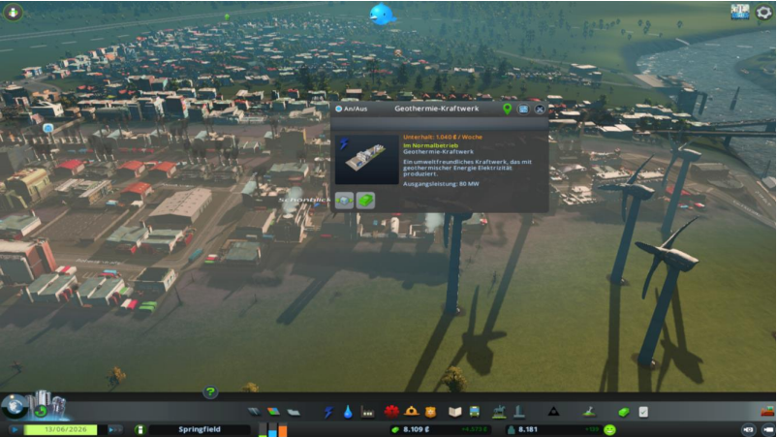
Findings and Educational Implications
Positive findings and potential applications
Identification of C:S limitations
Strategies for educators

Slide 6
Limitations and Critiques
Lack of in-game feedback for sustainability
Absence of democratic decision-making processes

Slide 7
Future Scopes
Ideas for potential applications
Future research directions
"Cities: Skylines 2" announcement

Slide 8
Conclusion
Key findings
Summary of the primary discoveries
Emphasis on educational potential
Reinforces the importance of "Cities: Skylines" in education
Call for ongoing research
Encourages further exploration in this field.

